Slide 1
Capstone Engagement
Assessment, Analysis, and Hardening of a Vulnerable System

Slide 2
Table of Contents
This document contains the following sections:
01
Network Topology
02
Red Team: Security Assessment
03
Blue Team: Log Analysis and Attack Characterization
Hardening: Proposed Alarms and Mitigation Strategies
04

Slide 3
Network Topology
‹#›

Slide 4
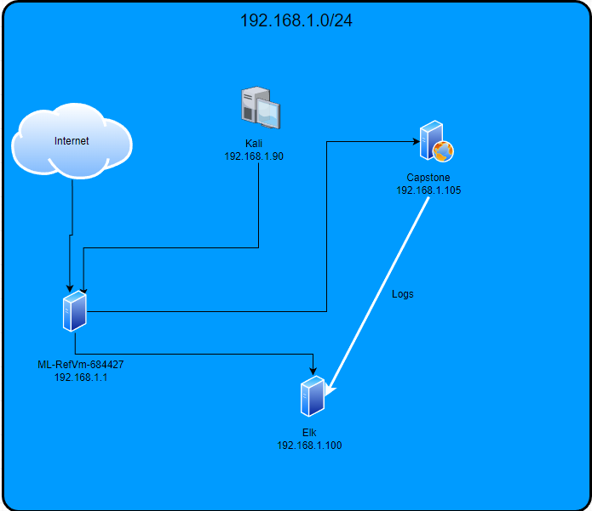
Logical Network Topology
Network
Address Range: 192.168.1.0
Netmask: /24
Gateway:
Machines
IPv4: 192.168.1.1
OS: Microsoft Windows 10 Pro
Hostname: ML-RefVm-684427
IPv4: 192.168.100
OS: Ubuntu 18.04.4 LTS
Hostname: Elk
IPv4: 192.168.1.105
OS: Ubuntu 18.04.1 LTS Server
Hostname: Capstone
IPv4: 192.168.1.90
OS: Kali Linux
Hostname: Kali

Slide 5

Red Team
Security Assessment
‹#›

Slide 6
Recon: Describing the Target
Nmap identified the following hosts on the network:
Hostname | IP Address | Role on Network
ML-RefVm-684427 | 192.168.1.1 | Gateway
Elk | 192.168.1.100 | Log aggregator
Capstone | 192.168.1.105 | Web server
Kali | 192.168.1.90 | Attacker

Slide 7
Vulnerability Assessment
The assessment uncovered the following critical vulnerabilities in the target:
Vulnerability | Description | Impact
Use the CVE number if it exists. Otherwise, use the common name. | Describe the vulnerability. | Describe what this vulnerability allows the attacker to do.
Exposed user role and location of secret_folder. | Meet_our_team folder exposes location and existence of secret_folder and role of Ashton as admin. | Allows an attacker access to the secret_folder which contains information enabling further escalation.
Exposed password hash | The secret folder contains Ryan’s password hash for a webdav share. | Allows an attacker access to a webdav share and provides access to a new password.
Available webdav share | An available web share combined with the above information provides access | Allows an attacker to place a payload on the webdav and to obtain shell access

Slide 8
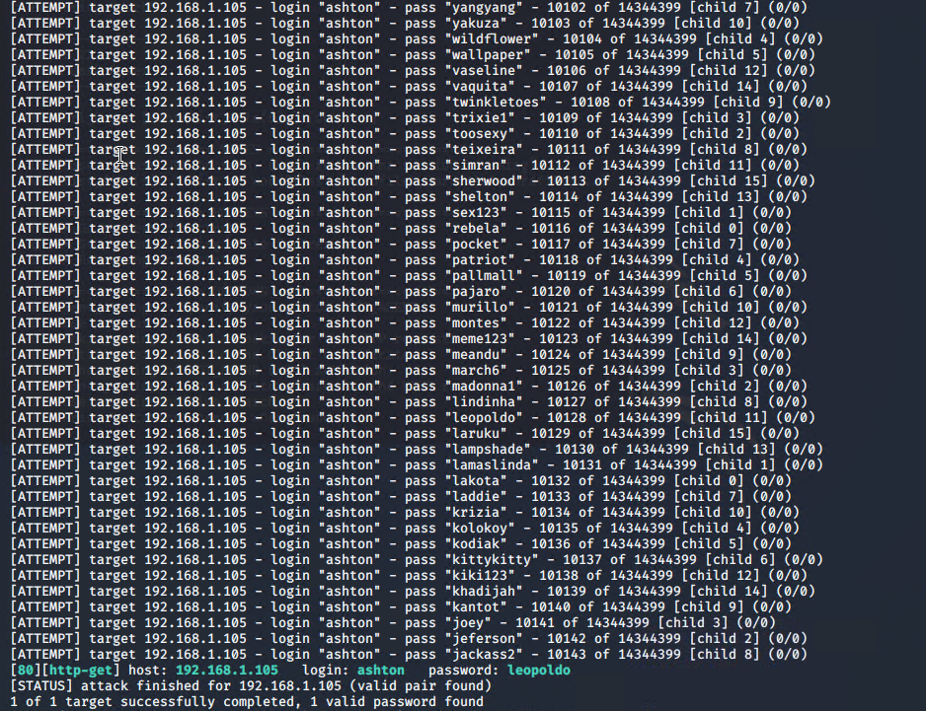
Exploitation: [Exposed Secret Folder]
01
02
03
Tools & Processes
Reconnaissance provided information that Ashton manages the secret_folder. This exposed his role and the existence and location of the secret_folder.
Hydra was used to brute force Ashton’s password particularly as his name was used as the login.
Ashton’s password appears in the rockyou.txt file.
Achievements
This exploit granted us access to the secret_folder.

Slide 9
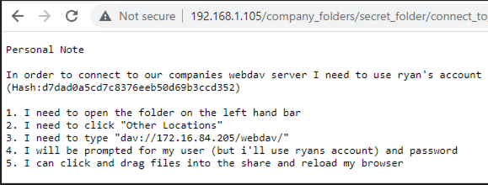
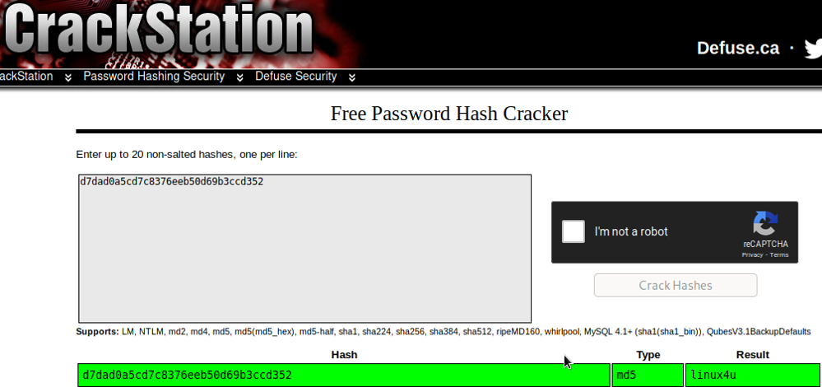
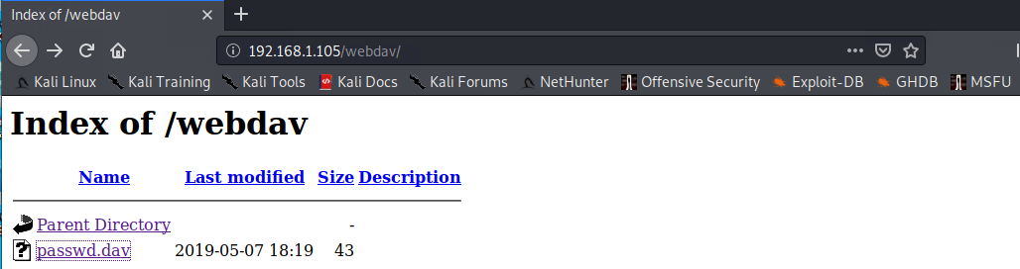
Exploitation: [Exposed user hash]
01
02
03
Tools & Processes
The previous exploitation gave us access to the secret_folder. This contains a password hash and location of a webshare.
Crackstation was used to recover the password. This allows us to gain access to the webshare.
Davtest was used to determine what type of files could be uploaded.
Achievements
This enabled access to a webshare. Davtest confirmed that we are able to place .php files on the webshare.
Further webdav contains another exposed password.
[INSERT: screenshot or command output illustrating the exploit.]

Slide 10
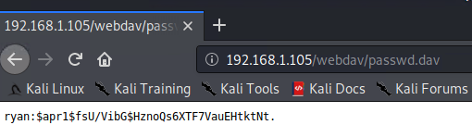
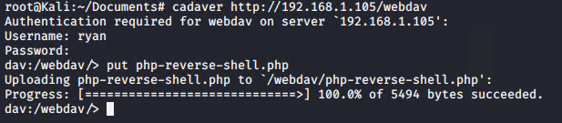
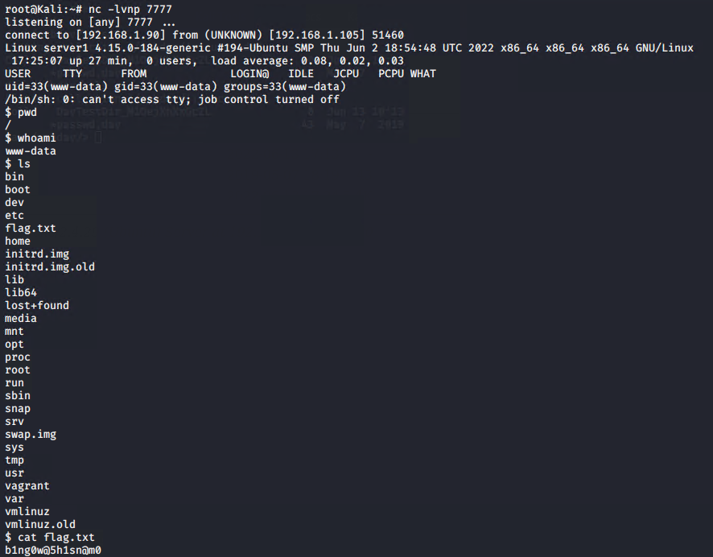
Exploitation: [Php-reverse-shell.php]
01
02
03
Tools & Processes
Cadaver was used to gain access to the webdav. This allowed the placement of a php-reverse-shell.php on the web server.
A listener was opened through netcat and connection was made through execution of the .php.
Achievements
This exploit allowed the user to obtain shell on the web server. This gave access to the flag.txt. Further exploitation is possible, including escalation to a full shell and root access.

Slide 11

Blue Team
Log Analysis and Attack Characterization
‹#›

Slide 12

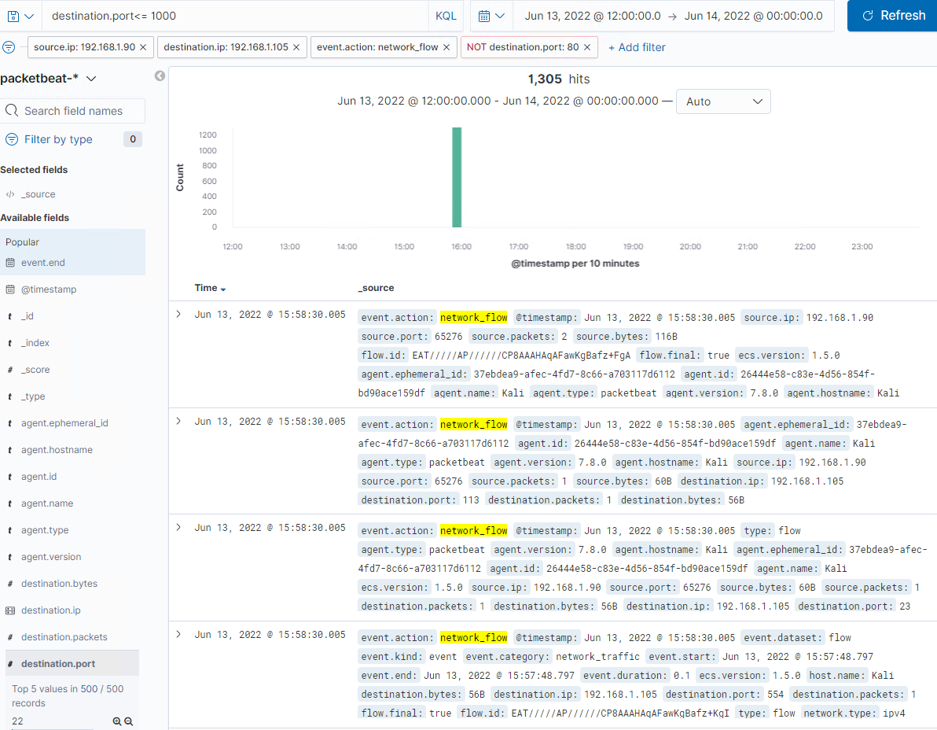
Analysis: Identifying the Port Scan
Answer the following questions in bullet points under the screenshot if space allows. Otherwise, add the answers to speaker notes.
What time did the port scan occur?
How many packets were sent, and from which IP?
What indicates that this was a port scan?
[Insert Here]
I
The port scan occurred at 15:58 on June 13th, 2022.
1305 packets were sent from IP 192.168.1.90.
The fact that a large number of packets were sent, each to a different commonly used port indicates this was a port scan.

Slide 13
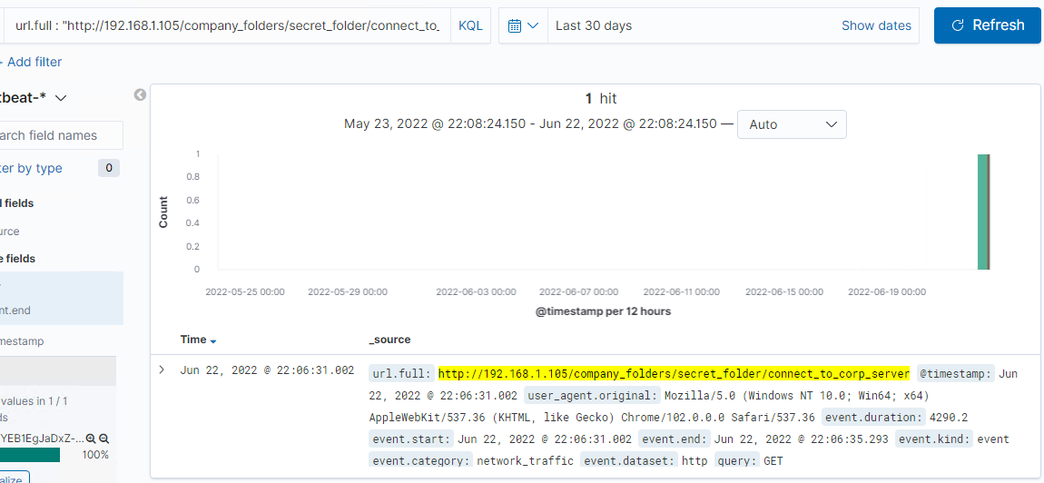
Analysis: Finding the Request for the Hidden Directory
Answer the following questions in bullet points under the screenshot if space allows. Otherwise, add the answers to speaker notes.
What time did the request occur? How many requests were made?
Which files were requested? What did they contain?
[Insert Here]
The request occurred at 22:06 on Jun 22, 2022 (as person forgot to originally make request for file).
The file requested was the connect_to_corp_server.txt which contains directions and password hash for webdav.

Slide 14
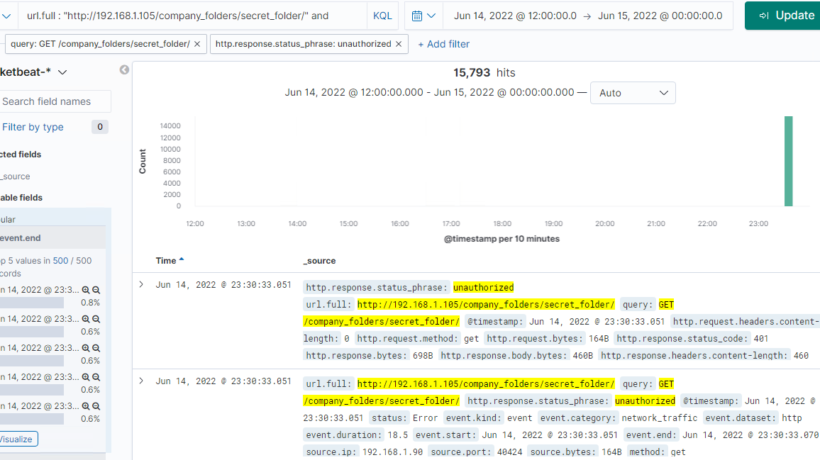
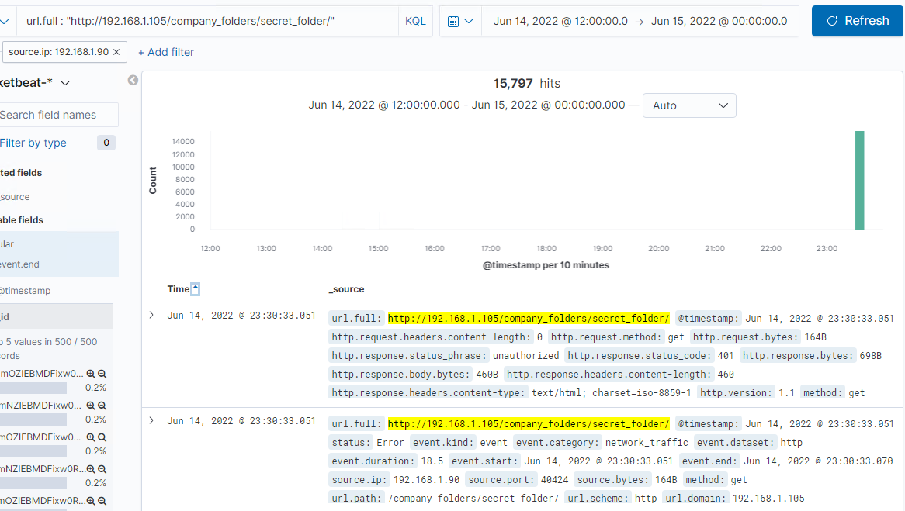
Analysis: Uncovering the Brute Force Attack
Answer the following questions in bullet points under the screenshot if space allows. Otherwise, add the answers to speaker notes.
How many requests were made in the attack?
How many requests had been made before the attacker discovered the password?
[Insert Here]
Include a screenshot of Kibana logs depicting the brute force attack.
15,797 requests were made in the attack total.
15,793 were made before the attacker discovered the password.

Slide 15
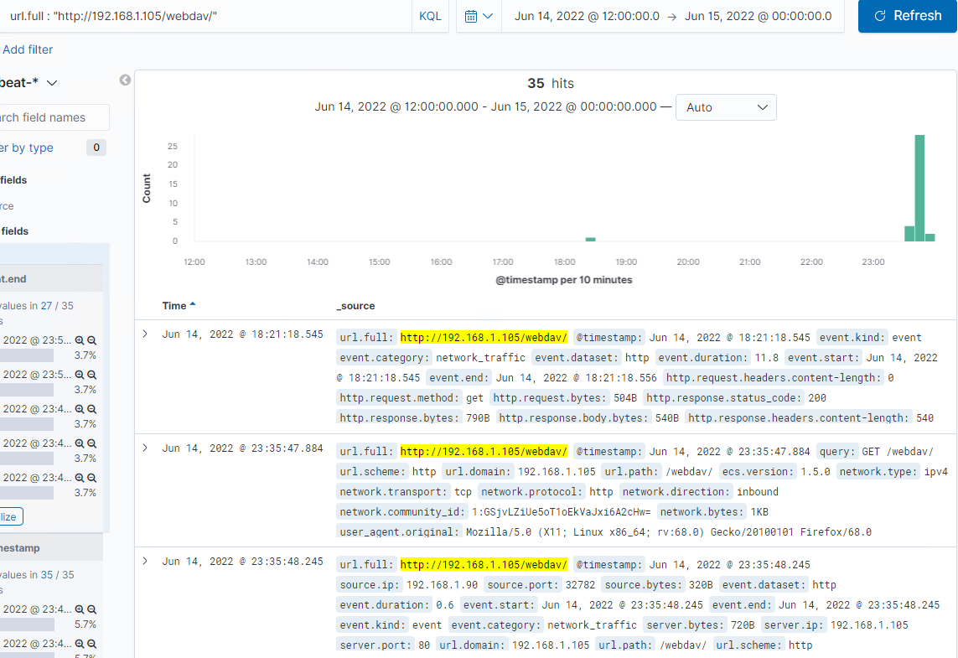
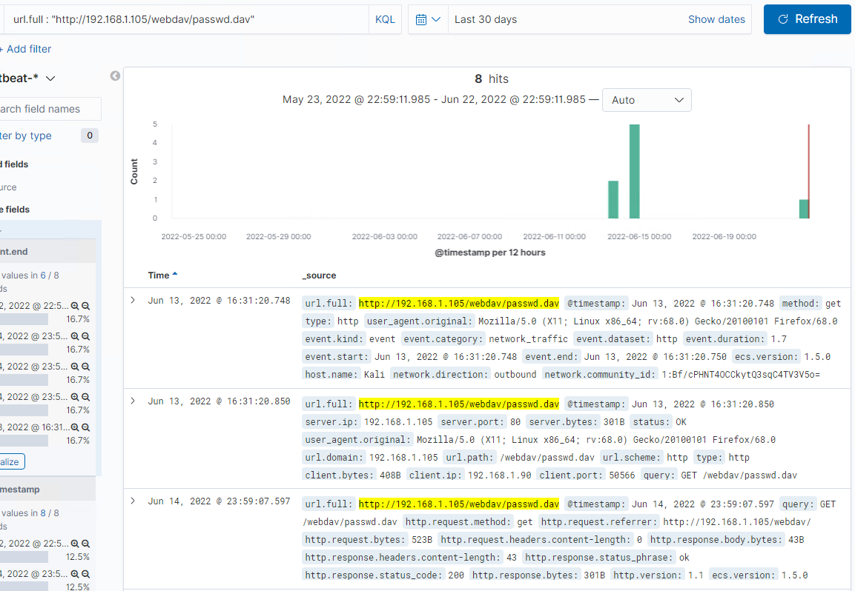
Analysis: Finding the WebDAV Connection
Answer the following questions in bullet points under the screenshot if space allows. Otherwise, add the answers to speaker notes.
How many requests were made to this directory?
Which files were requested?
35 requests were made to this directory.
The file passwd.dav was requested.

Slide 16
Blue Team
Proposed Alarms and Mitigation Strategies
‹#›

Slide 17
Mitigation: Blocking the Port Scan
What kind of alarm can be set to detect future port scans?
Based on number of packets with different port numbers received from an IP address in a period of time.
What threshold would you set to activate this alarm?
I recommend an alarm if 10 packets with different port numbers are received from the same IP address over 1 second.
What configurations can be set on the host to mitigate port scans?
Unnecessary ports and services should be closed.
Firewall set to block anonymous requests.
Describe the solution. If possible, provide required command lines.
Firewall rule to drop packets from an IP address when packets with 10 or more port numbers are received in 1 second.

Slide 18
Mitigation: Finding the Request for the Hidden Directory
What kind of alarm can be set to detect future unauthorized access?
An alarm can be set to detect login attempts to the hidden directory.
What threshold would you set to activate this alarm?
I would set the alarm threshold between 3 to 5 attempts per hour.
What configuration can be set on the host to block unwanted access?
The hidden folder should not be accessible to the public.
An unsalted hash should not be available.
Passwords should not be shared.
Describe the solution. If possible, provide required command lines.
The description of the secret_directory should be removed from the site.
A whitelist can be used for authorized IP addresses

Slide 19
Mitigation: Preventing Brute Force Attacks
What kind of alarm can be set to detect future brute force attacks?
Based on number of attempted logins indicated by unauthorized client errors (HTTP 401).
What threshold would you set to activate this alarm?
I would set the threshold to 6.
What configuration can be set on the host to block brute force attacks?
Block an IP address after more than 6 unsuccessful attempts.
Have a comprehensive password policy.
Whitelist IP addresses.
Require 2FA if possible.

Slide 20
Mitigation: Detecting the WebDAV Connection
What kind of alarm can be set to detect future access to this directory?
Alarm can be set on HTTP GET or dav PROPFIND (finds dav directory structure).
What threshold would you set to activate this alarm?
Unless heavily trafficked would be set for any attempts made.
What configuration can be set on the host to control access?
Set firewall to only allow whitelist IP addresses to access folder.
Use TLS (HTTPS) and 2FA to protect logins.

Slide 21
Mitigation: Identifying Reverse Shell Uploads
What kind of alarm can be set to detect future file uploads?
Alarm on any uploads to webdav.
What threshold would you set to activate this alarm?
Any 1 upload
What configuration can be set on the host to block file uploads?
Set access to read only unless uploads are required.
Use HTTPS and 2FA to restrict file uploads to allowed users.
Close unnecessary services and ports
Disable executables running in webdav unless needed
Block egress traffic via firewall as much as possible
Run davtest to help restrict what types of files can be uploaded to webdav

